Slide 1


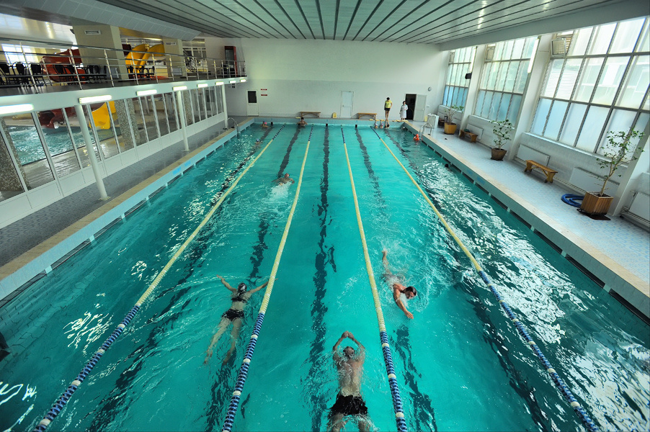
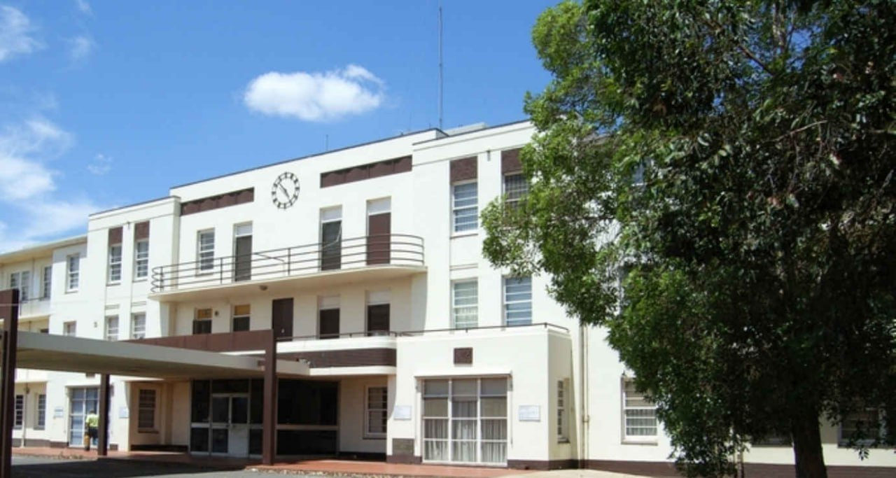
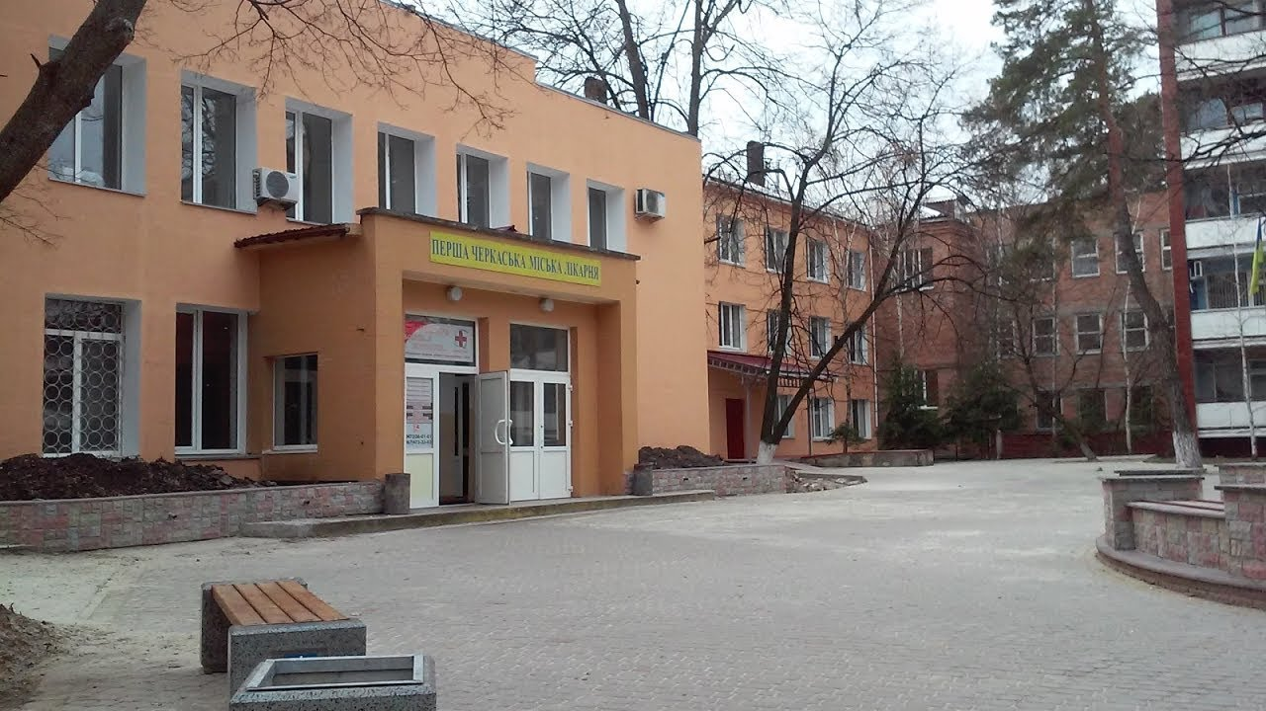


Overhaul of the building of Municipal non-profit enterprise «First Cherkasy City Hospital»

Slide 2


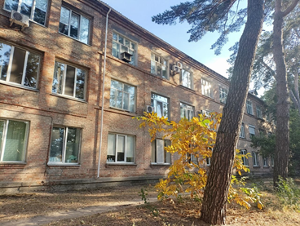

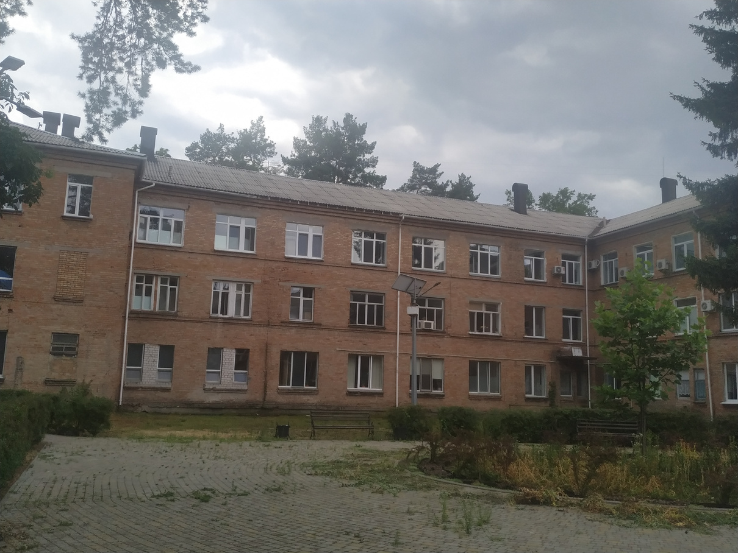







Overhaul of the building of Municipal non-profit enterprise «First Cherkasy City Hospital»
A multidisciplinary medical institution with bed fund of 355 beds.
15 departments with the only burn department for adults and children in the region.
Currently, the number of visitors of the institution:
9 773 patients treated in inpatient care per year
3 463 surgical interventions were performed
Provision of specialized care 24/7
The total cost of the project is
≈ 1 207 500 EUR

Slide 3


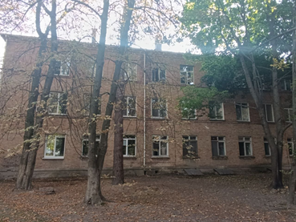





The project includes the following works:
roof repair
insulation of facades
replacement of external windows and doors
interior finishing of the passage and stairwells
replacement of electrical networks and equipment

Slide 4
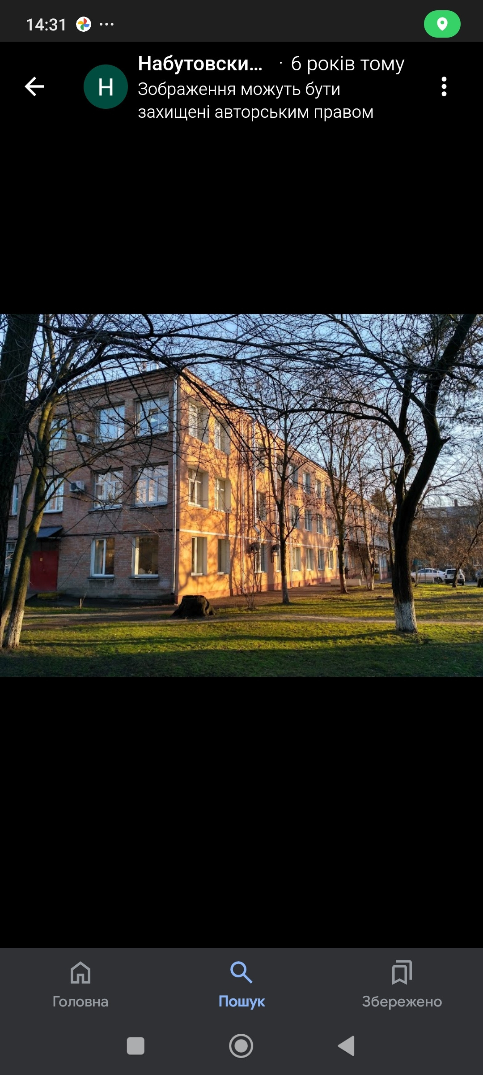


The oldest three-story building, was put into operation in 1963
Completion of construction works at the facility will ensure:
creation of necessary and high-quality conditions
providing medical care to patients with various diseases by creating a modern medical complex using modern materials and energy-saving technologies, inclusiveness

